Slide 1
CRUD operations in Mongo DB

Slide 2
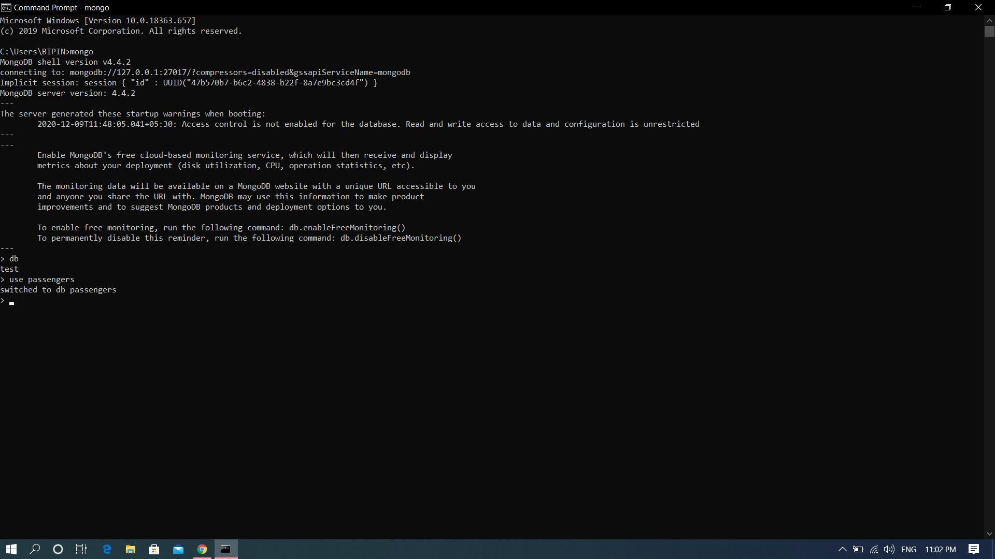
Creation

Slide 3
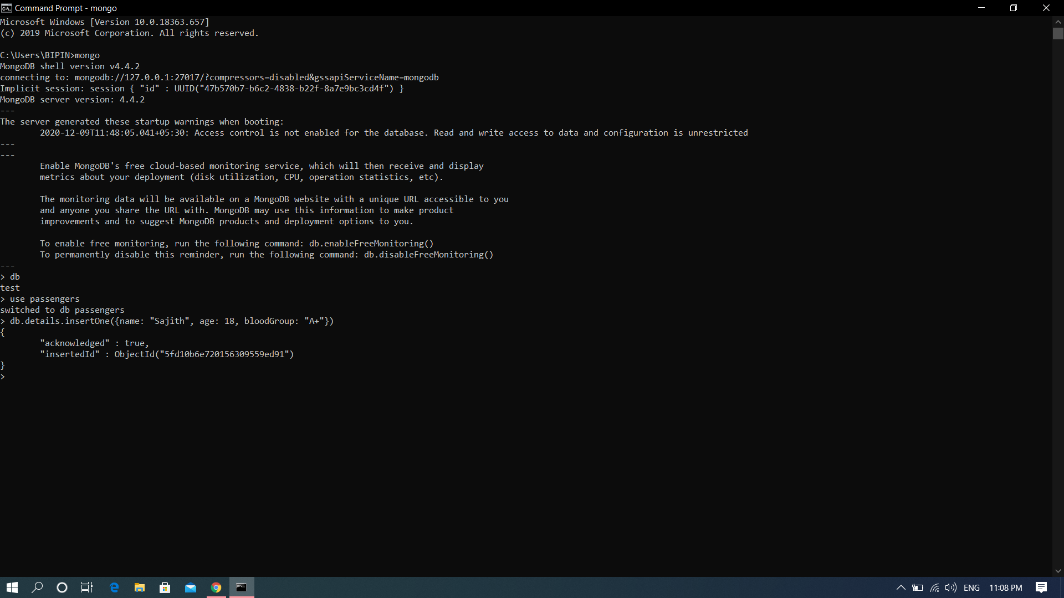
insertOne()

Slide 4
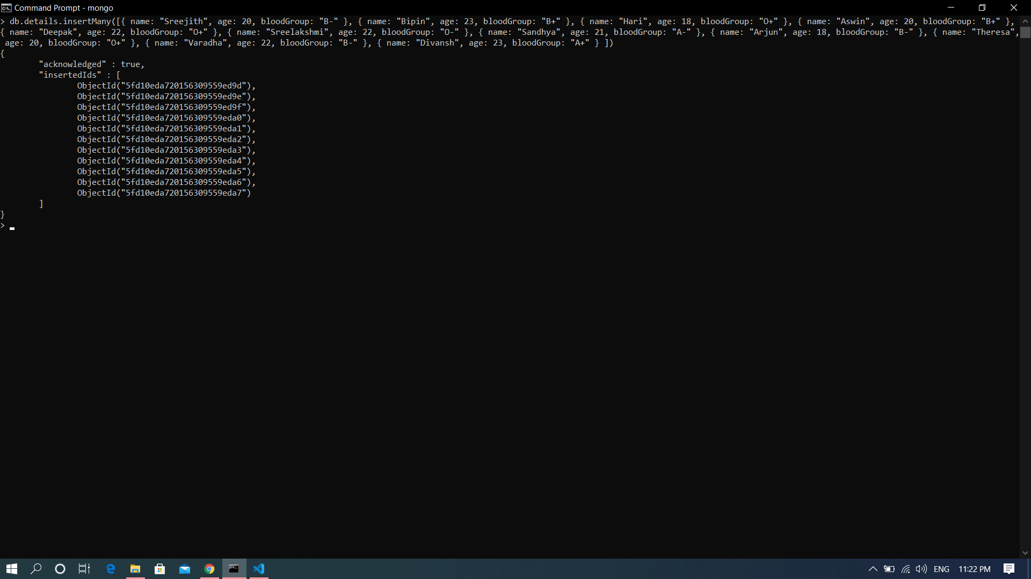
insertMany()

Slide 5
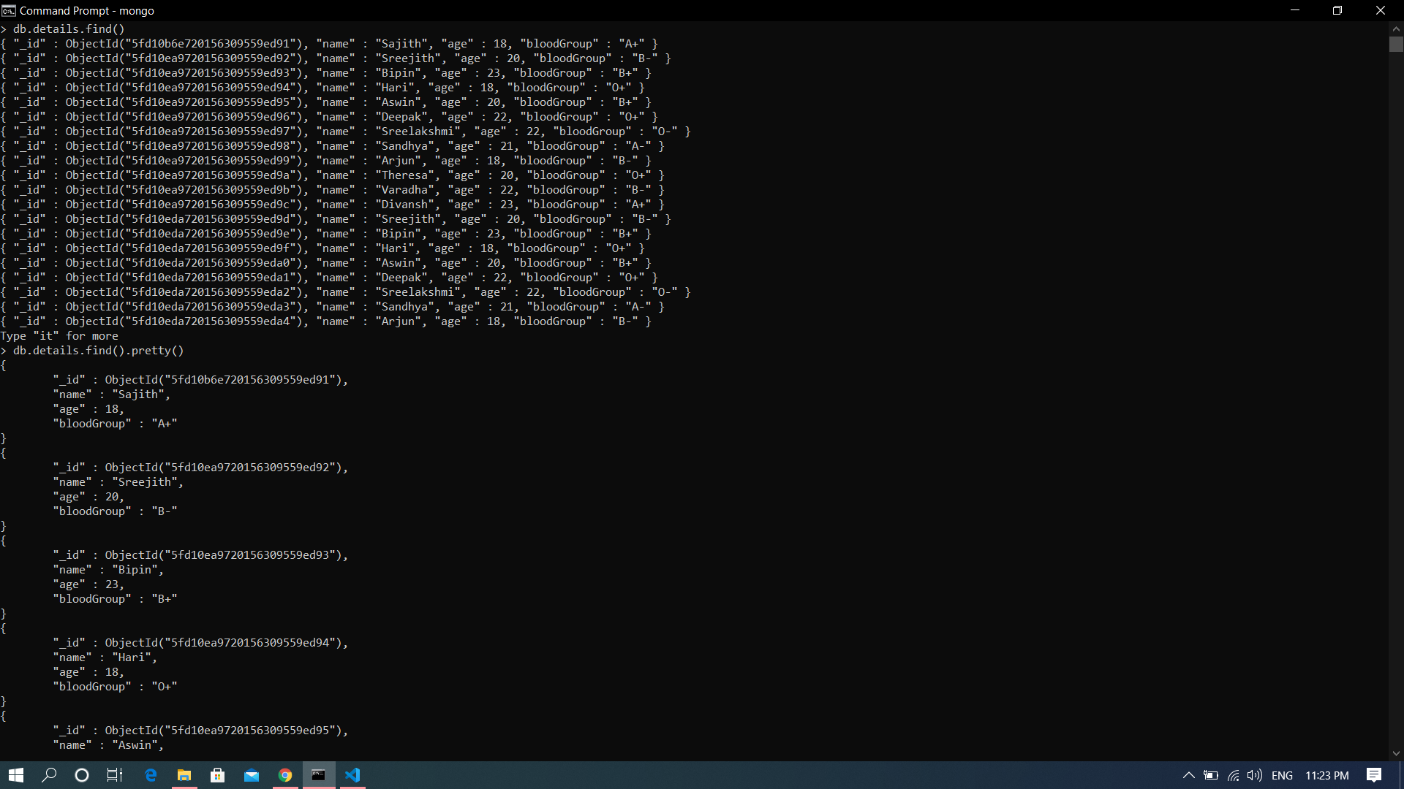
Read – find() and find().pretty()

Slide 6
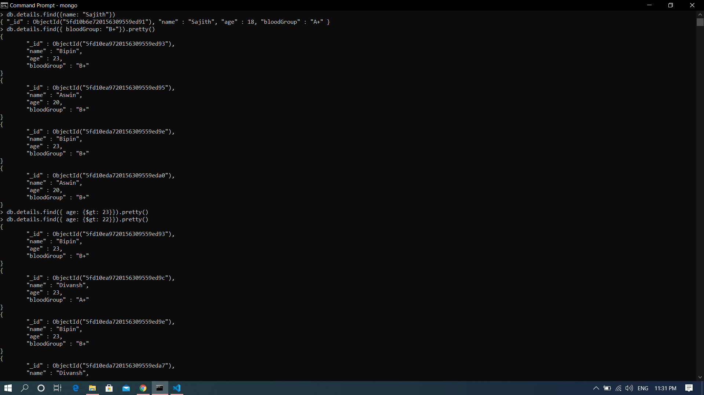
find(query)

Slide 7
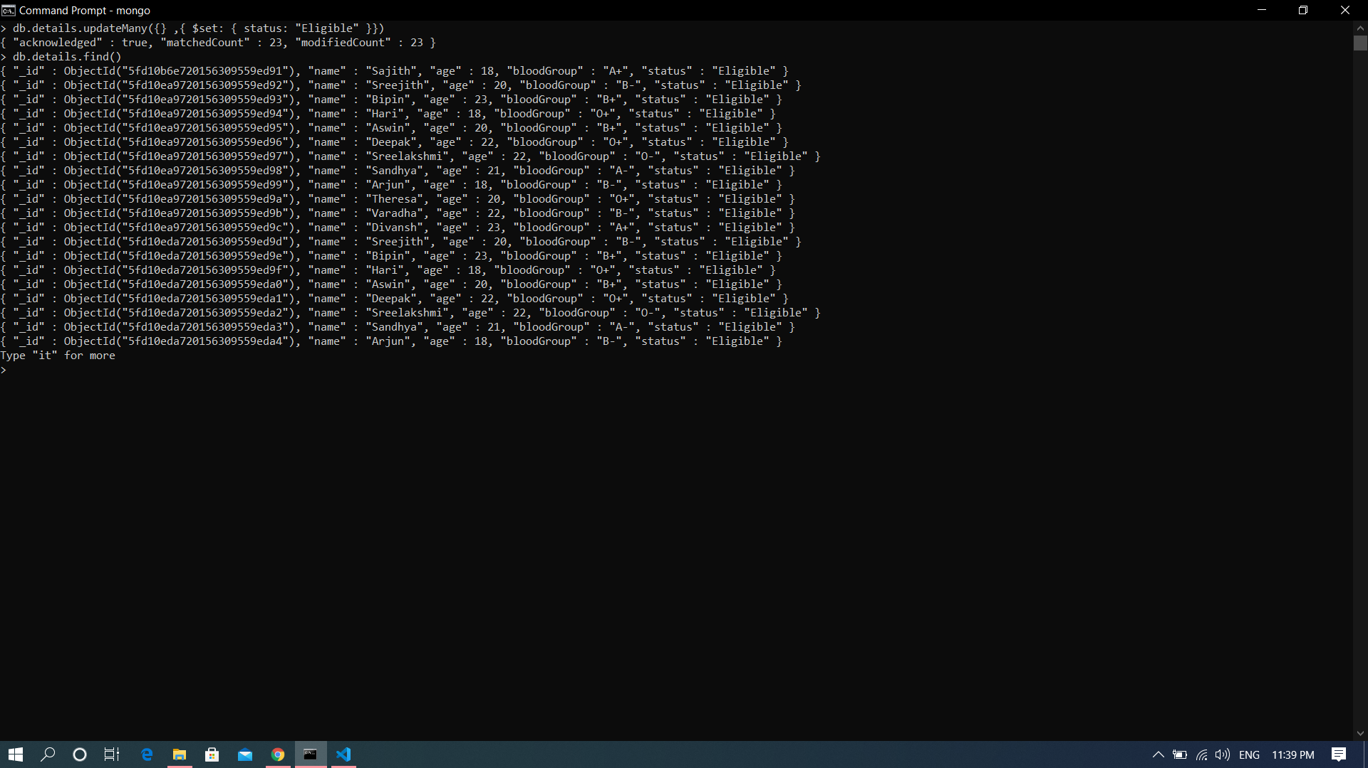
Update - updateMany()

Slide 8

replaceOne()

Slide 9
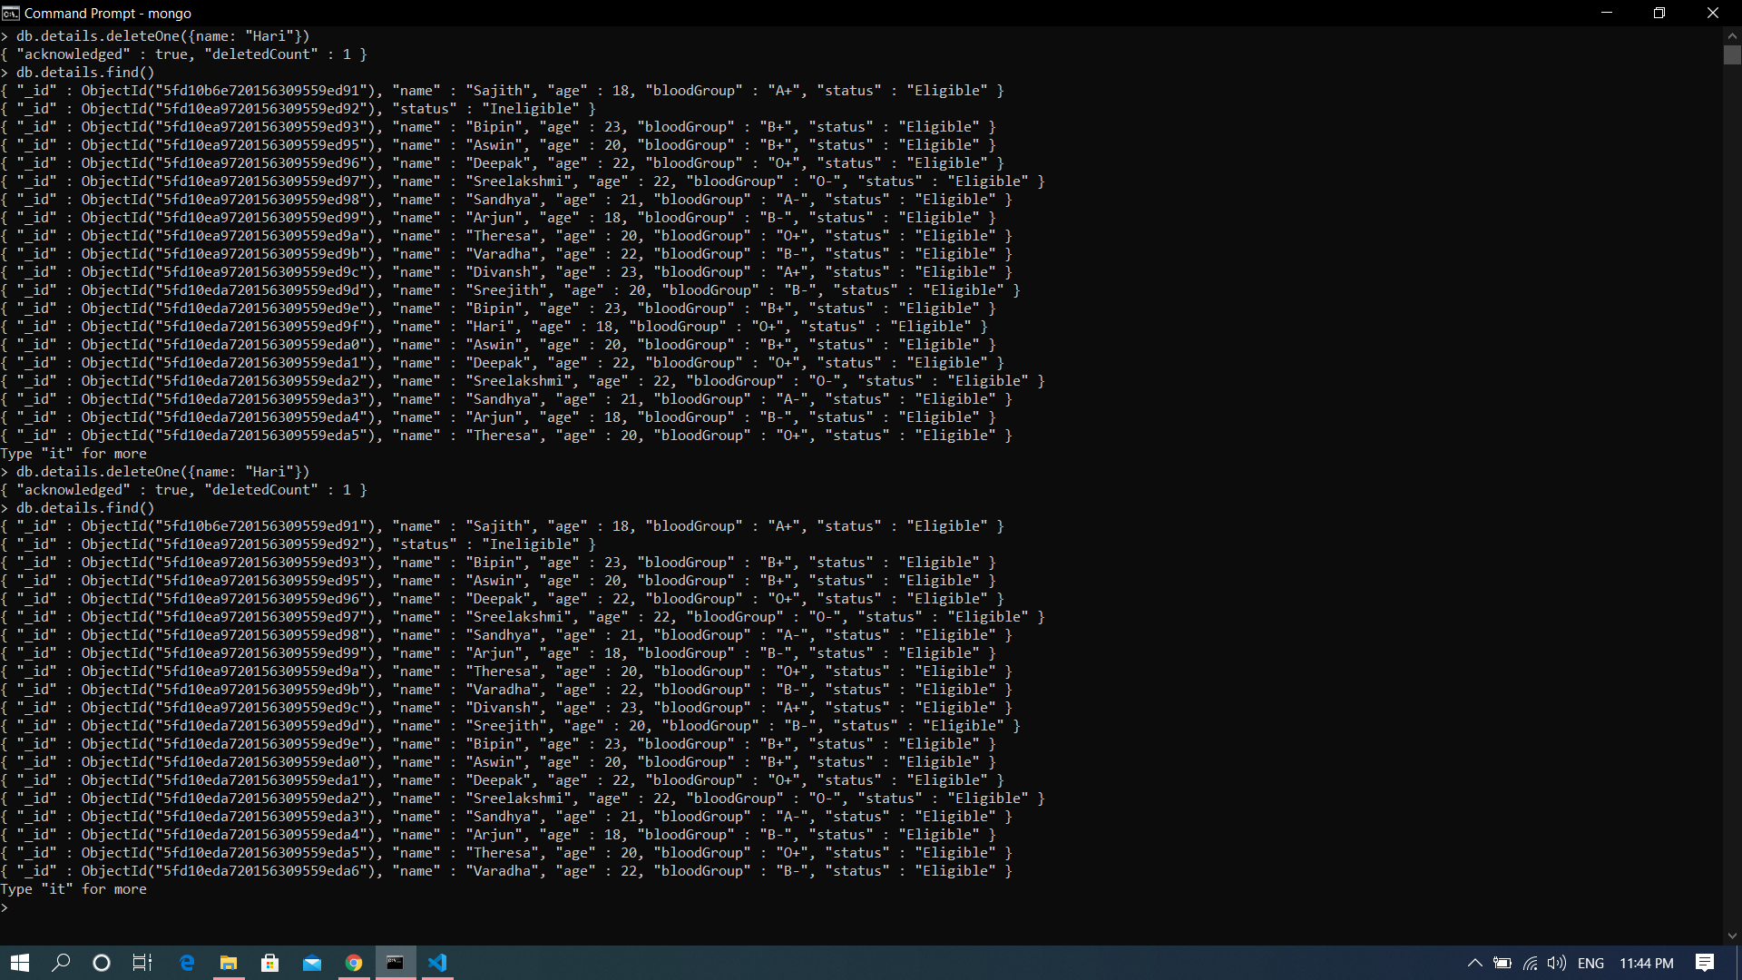
Delete – deleteOne()

Slide 10
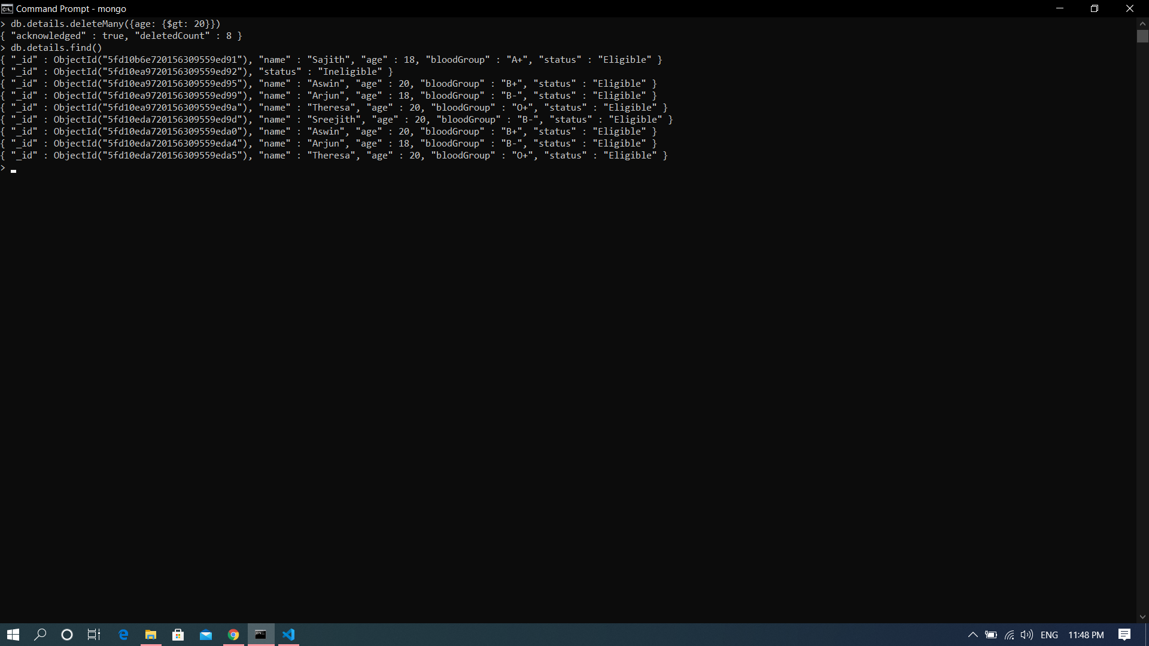
deleteMany()

